Slide 1


Multimodal Alignment of Scholarly Documents and Their Presentations
Slides Available: http://bit.ly/1bMSJee
Bamdad Bahrani and Min-Yen Kan

Slide 2
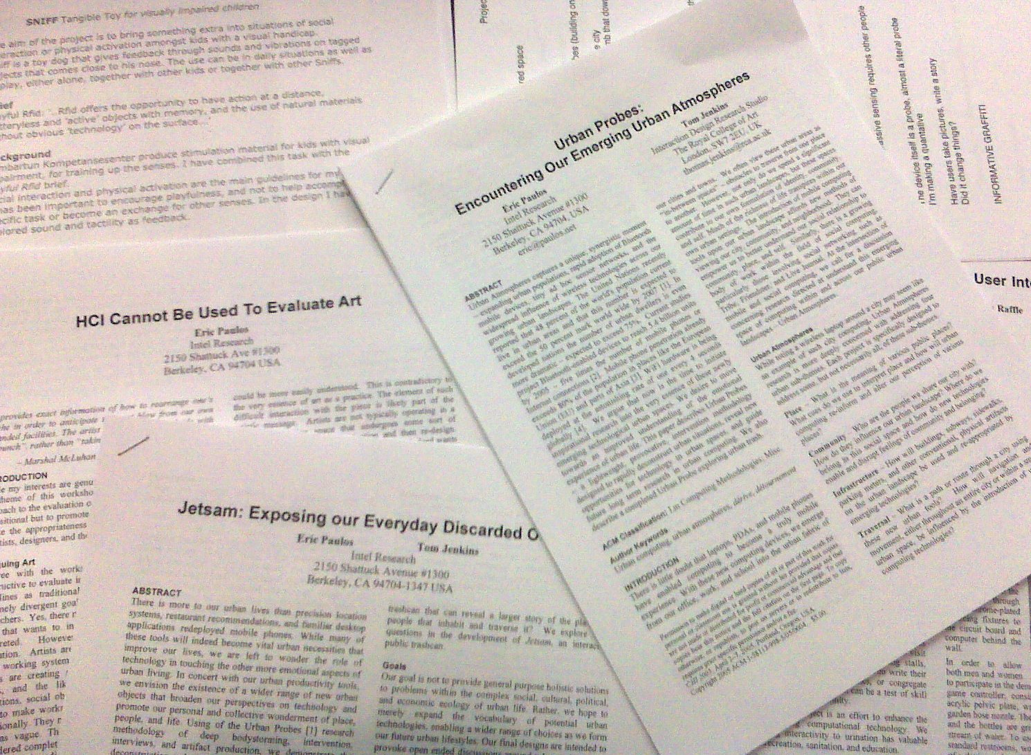
Slides Available: http://bit.ly/1bMSJee
We read papers, lots of papers!
How do we make sense of this knowledge?
By reading the proceedings?
Photo Credits: Mike Dory @ Flickr
Notes:
Do you think reading title, abstract and conclusion is not enough to understand what is going on in the paper?
Are you looking for a summary of the paper which includes most important issues discussed in the paper?

Slide 3

Slides Available: http://bit.ly/1bMSJee
We attend conferences in part to help learn from each other.
A key artifact is the slide presentation, which often summarizes the work in an accessible manner.
But they:
Are not detailed enough
Miss important technical details
Idea: Use both together
Photo Credits: Xeeliz @ Flickr

Slide 4
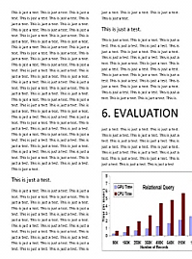
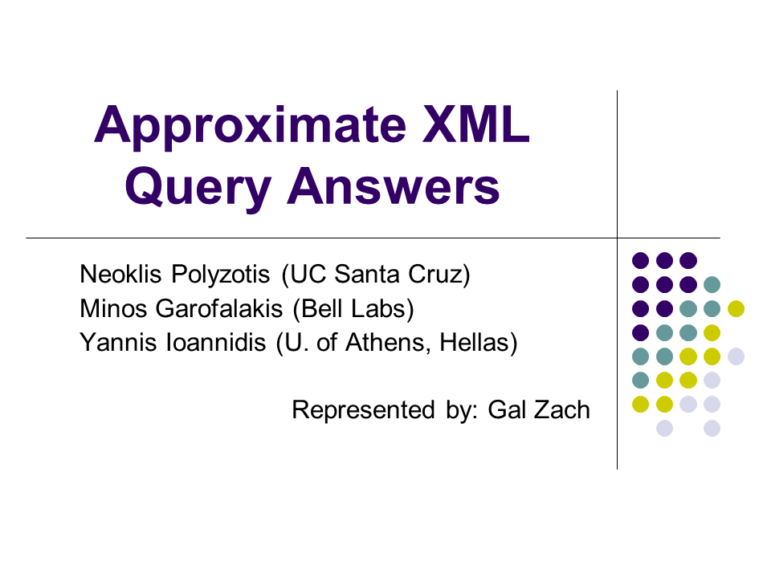
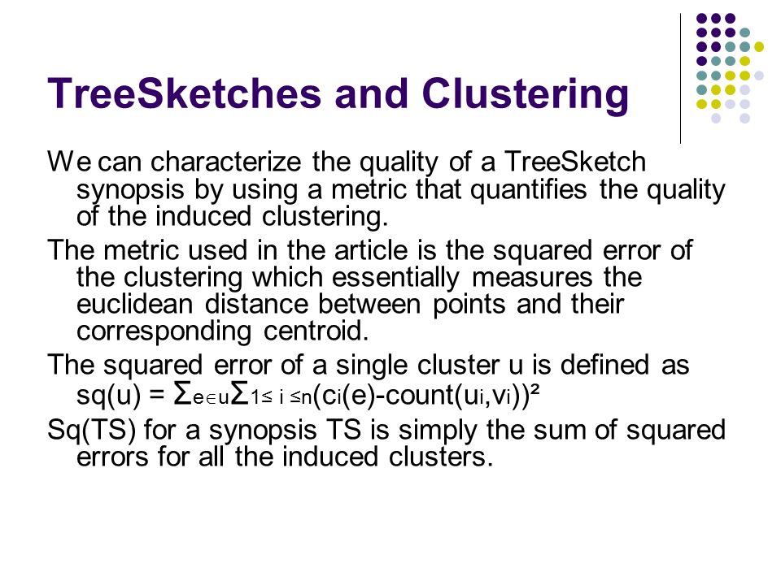
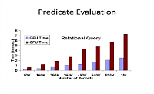
ALIGNING PAPERS TO THEIR PRESENTATIONS
Better to juxtapose both media together in a fine-grained manner.
Output: an alignment map
Notes:
So, assuming that we have the paper […wait…] and its associated slide presentation […wait…] , it would be very helpful if we can view them together[…wait…] in a way that we know each slide[…wait…] is related to which section[…wait…] of the paper.
We call this relation an “alignment map” […wait…]

Slide 5
PROBLEM STATEMENT
Generate an alignment map for a pair
Paper, containing m (sub)sections and
Presentation, containing n slides
A slide-centric alignment: Each slide is aligned to
either a section of the paper, or
unaligned (termed nil alignment)
Notes:
In this research, we try to generate the alignment map for a pair of paper-presentation.

Slide 6
OUTLINE
Motivation and Problem Statement
Baseline Analysis on an Existing Dataset
Methodology – Multimodal Alignment
Experimental Results

Slide 7
RELATED WORK
How can we improve on past work?
We note that none of it considered visual content.
 | Hayama et al 2005 | Ephraim 2006 | Kan 2007 | Beamer & Girju 2009 | Our Work – Multimodal Alignment
Text similarity | ✓ | ✓ | ✓ | ✓ | ✓
Monotonic alignment | ✗ | ✓ | ✓ | ✗ | ✓
Nil identification | ✗ (Suggested) | ✗ (Suggested) | ✓ | ✗ (Suggested) | ✓
Visual content | ✗ | ✗ | ✗ | ✗ | ✓
Notes:
There are some studies trying to address the same problem.
They all suggest using the text similarity between paper and presentation to align them together. They implemented different similarity measures though.
Kan and Ephraim suggest the alignment process to prefer monotonic alignment, meaning that slides and paragraphs in the paper be aligned in the same order.
Kan also implemented nil classifier which identifies the slides which should not be aligned to anywhere. All other works suggest that this can improve the results, but didn’t implement.
None of them however take advantage of visual content of the slides for this task.
We use text alignment method same as previous works, we also implement monotonic alignment, nil classifier. In addition as our main contribution, we make use of visual cues from the slide to complement the textual alignment.

Slide 8
ANALYSIS OF A BASELINE
Use the public dataset from (Ephraim, 2006).
20 Presentation–Paper pairs
Papers in .PDF, source DBLP
Sections / Subsections
Presentations in .PPT, verified to have been constructed by same author
Slides
Notes:
We use a publicly available dataset which was compiled by Ephraim. It contains…

Slide 9
ANALYSIS OF A BASELINE
Use the public dataset from (Ephraim, 2006).
20 Presentation–Paper pairs
Papers in .PDF, source DBLP
Sections / Subsections
Presentations in .PPT, verified to have been constructed by same author
Slides
Total number of sections | 515
Average number of sections per paper | 25.75
Total number of slides | 751
Average number of slides per presentation | 37.5
Notes:
We use a publicly available dataset which was compiled by Ephraim. It contains…

Slide 10

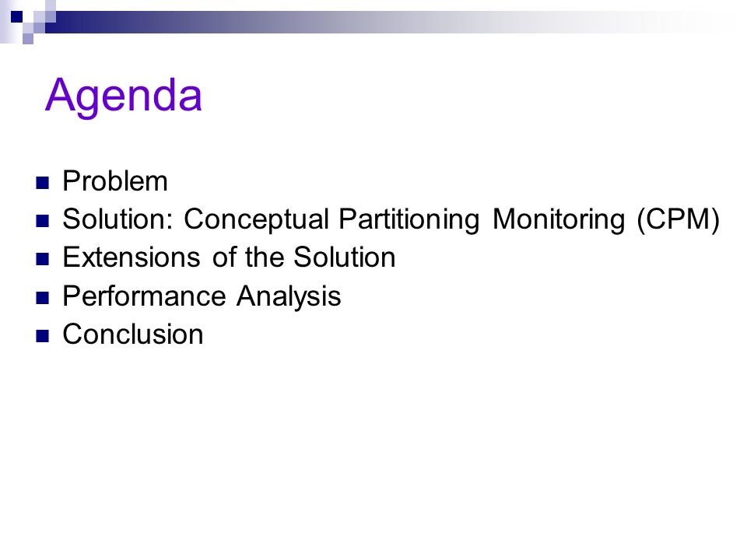
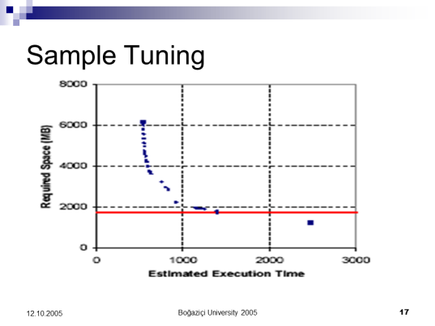
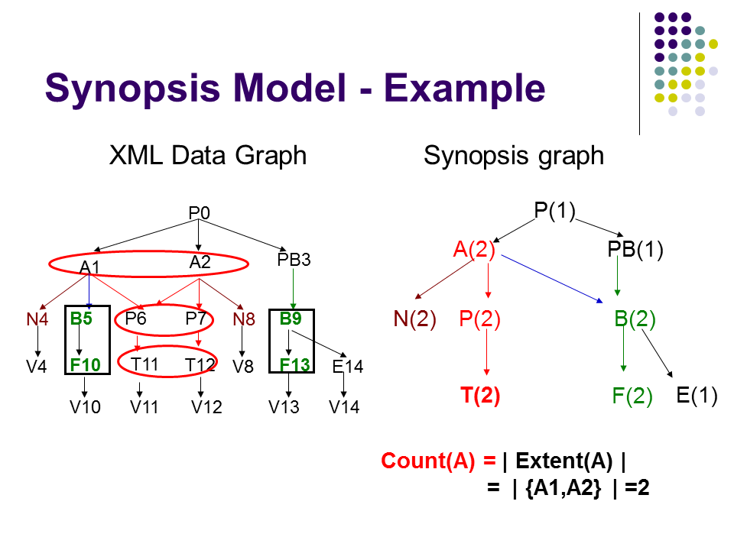
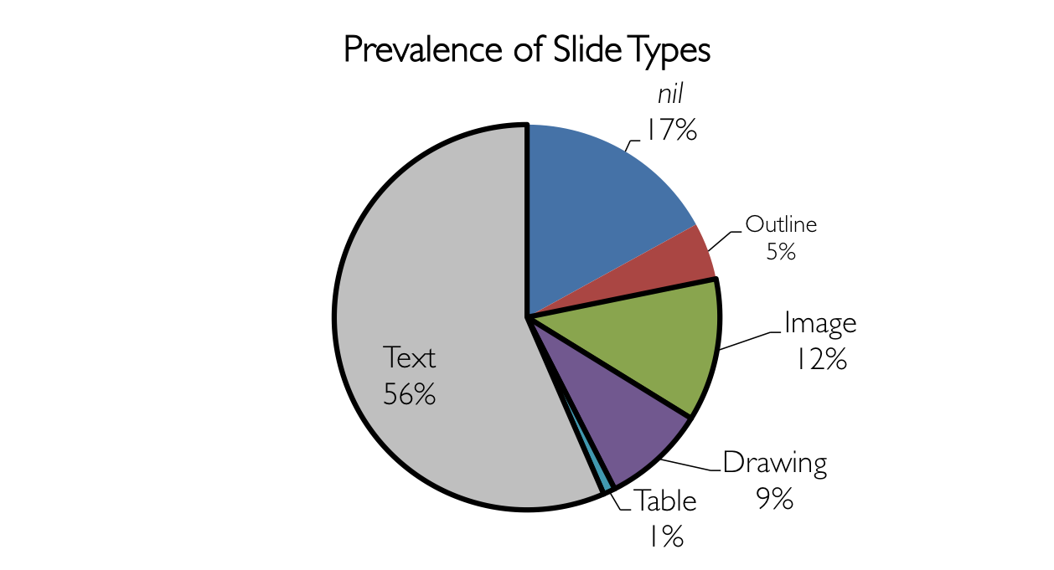
DEMOGRAPHICS
Notes:
We perform an analysis to see what type of slides exist in presentations, and what is their frequency.
Nil reported from 3% to 25%
Image slides which constitute around 12% of the slides are mostly covered with images. This can range from charts and graphs to added pictures from another file or snapshots from the paper.
We define drawing slides as slides which was made using the presentation maker software(MS Powerpoint in this case). They usually contain lines and arrows, geometrical shapes and textboxes.
Tables are the one which are digitally made and stored. Many table slides are actually images from the table which our system can not go through the text inside that.

Slide 11
BASELINE ERROR ANALYSIS
Slide Type | Common reason | % Incorrectly Aligned by Baseline
Nil | Doesn’t know where to align → align to best fit | 64%
Outline | Name of some sections in it → align to longest one | 36%
Image | Very little text available | 81%
Drawing | Noisy data: lots of shapes and text boxes | 53%
Table | Little text, noisy data | 50%
Text |  | 24%
81%
Approximately 70% of these errors belong to “Evaluation” or “Results” slides
Notes:
We implemented a text alignment baseline (section to slide) and these were the errors that we got from that.
As can be seen, more than 80% of Image slide type are not aligned correctly.
And it is interesting to know that around 70% of slides in this type are showing “Evaluation and Result”

Slide 12
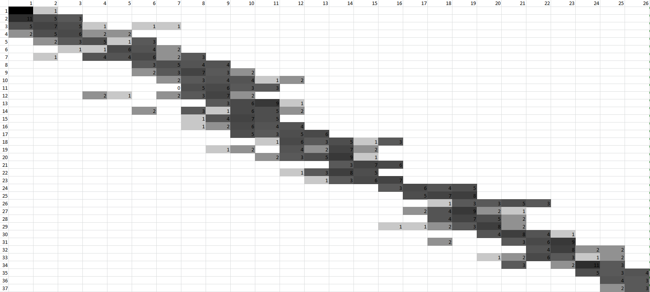
MONOTONIC ALIGNMENT
We observed that the alignment between slides and sections is largely monotonic.
Why 26 sections and 37 slides?
The average number of each in the pairs in the dataset.
Slides (1-37)
Sections (1-26)
New work! Not in the paper.
Notes:
TO MIN: This visualization was done latter in the thesis and is not mentioned in the paper.
Ordering between slides and sections are mostly monotonic.
To prove that we did an analysis. For all presentations and paper pairs, we scale the number of slides to 37 and sections to 26 (which was the average number of slides and sections). using the ground truth we then count the number of aligned pairs. In this picture darker cells indicate more pairs are aligned in the same section and slide number.

Slide 13
EVIDENCE FOR ALIGNMENT
Text Similarity (Baseline)
Between each slide and each section
Linear Ordering
Slides and sections are often monotonically aligned with respect to previous aligned pair
Visual Content
Represented by a slide image classifier

Slide 14
COMBINING EVIDENCE
Represent each of the three sources as a probability distribution or preference
Text Similarity
Linear Ordering
Visual Content
Handle obvious exceptions.
Weight distributions together to find most likely point as alignment.

Slide 15
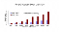
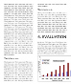
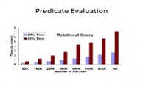
SYSTEM ARCHITECTURE
Multimodal Alignment
Slide Image Classifier
nil
Pre-
processing
Text Alignment
Ordering Alignment
Input: Presentation
Multimodal Alignment
Slide Image Classifier
1. Text
3. Drawing
nil
2. Outline
4. Results
Pre-
processing
Text Alignment
Linear Ordering Alignment
Output: Alignment map
Input: Document
Current architecture. Slightly different from published paper.
Notes:
TO MIN: This system architecture is a bit different with what was shown on the paper. The old one (same as the paper) is also available in backup slides at the end.
This is an overview of our system architecture.
Presentations and paper files go through preprocessing unit of the system. In the same time, slides snapshots go through image classifier unit.
Text similarity alignment and linear ordering alignment generate two vectors of alignment for each slide. These two will be combined considering the image class assigned to the slide and find the final alignment for the slide.

Slide 16
TEXT EXTRACTION
Multimodal Alignment
PRE-PROCESSING
Slide Image Classifier
nil
Pre-
processing
Text Alignment
Ordering Alignment
Presentation
Paper
Slide Text
Slide Number
Slides
MS PowerPoint VB compiler
Section Text
PDF
PDFx
XML
Parser
(via Python)

Slide 17
STEMMING AND TAGGING
Multimodal Alignment
PRE-PROCESSING
Slide Image Classifier
nil
Pre-
processing
Text Alignment
Ordering Alignment
Stemming
To conflate semantically similar words
For both the presentation and paper text
Replace each word with its stem e.g., “Tagging” → “Tag”
Part of Speech (POS) Tagging
To reduce noise
For the paper text
Tag all words, retaining only important tags: Noun, Verb, Adjective, Adverb and Conjunction
Notes:
TO MIN: Did not mention in the paper, however it was done even in that time.
POS removed 25% of words

Slide 18
1. TEXT SIMILARITY
ALIGNMENT MODALITY
Multimodal Alignment
Slide Image Classifier
nil
Pre-
processing
Text Alignment
Ordering Alignment
tf.idf cosine-based similarity measure
Previous works have all used textual evidence
We use it as baseline
Primary alignment component
For each slide s, computes similarity for all sections
Probability distribution
Outputs a text alignment vector (V_{Ts})

Slide 19
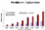
2. LINEAR ORDERING
ALIGNMENT MODALITY
Multimodal Alignment
Slide Image Classifier
nil
Pre-
processing
Text Alignment
Ordering Alignment
Outputs a linear alignment vector (O_{Vs}) for each slide s
Probability mass centered at
E.g., A presentation with 20 slides and 9 (sub-)sections:
1
2
3
4
5
6
7
8
9
10
11
12
13
14
15
16
17
18
19
20
0
0
0.1
0.2
0.4
0.2
0.1
0
0
1.
2.
2.1
3.
3.1
3.2
4.
5.
5.1
Notes:
N slides, M sections.
20 slides, 9 sections. Slide number 10

Slide 20
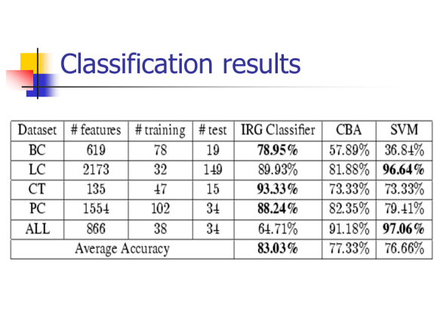
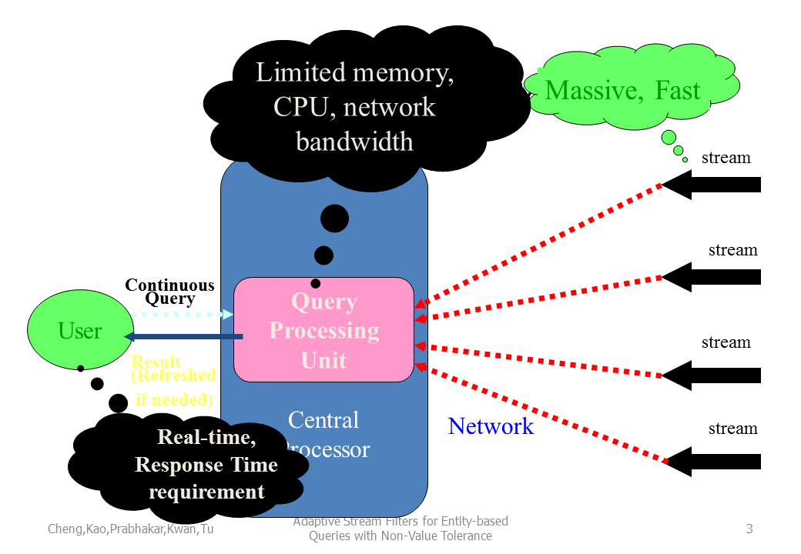
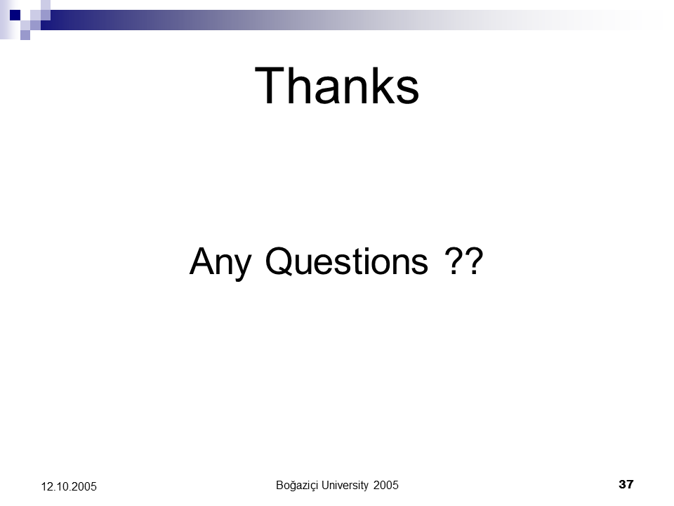
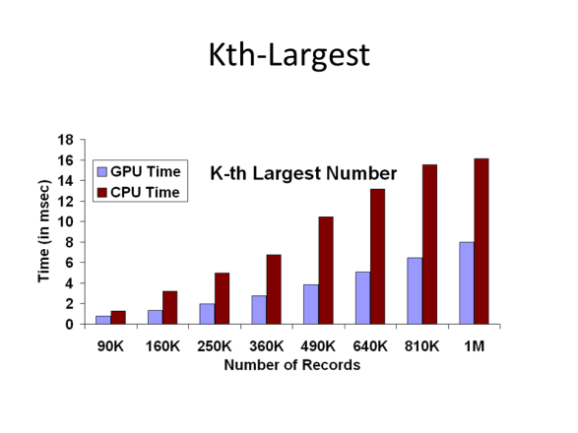
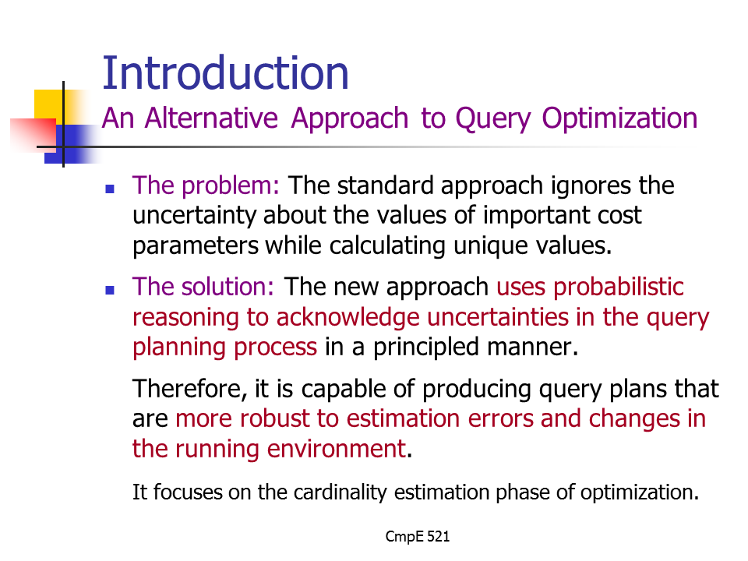
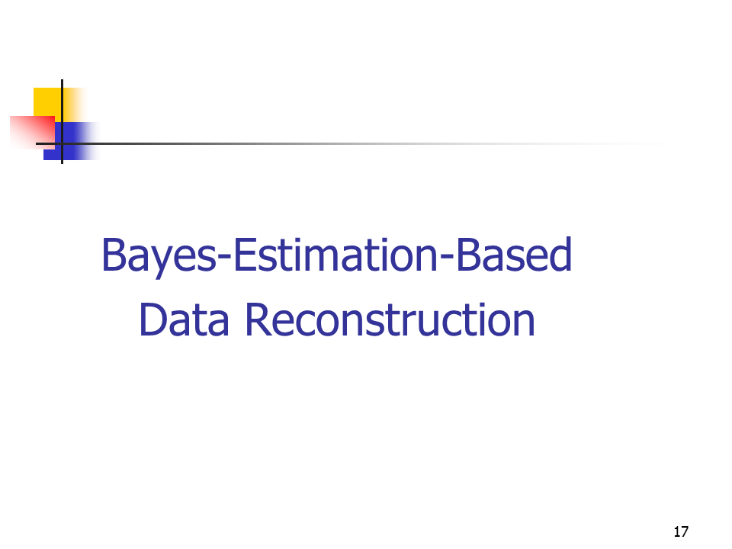
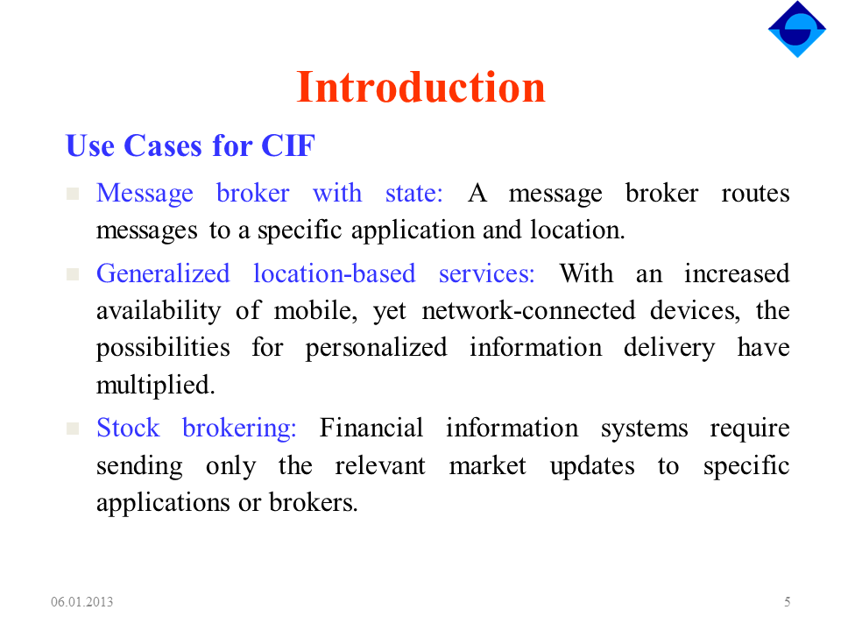
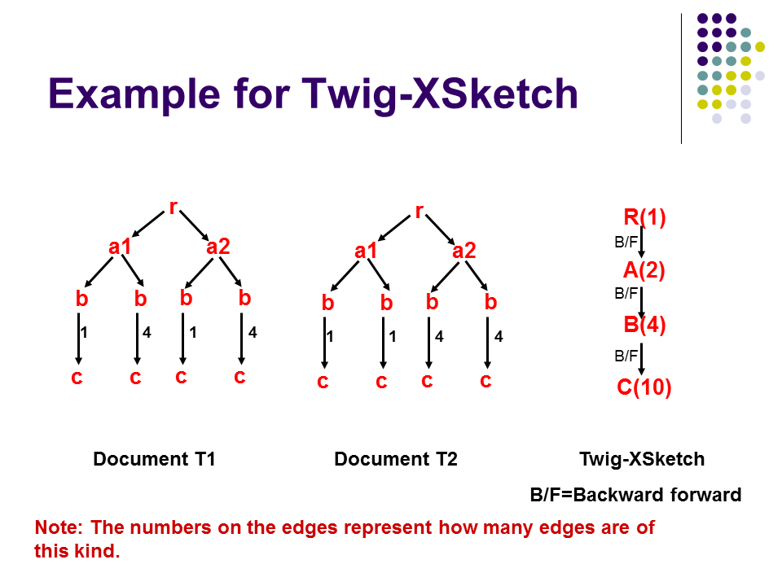
3. SLIDE IMAGE CLASSIFIER
Multimodal Alignment
ALIGNMENT MODALITY
Slide Image Classifier
nil
Pre-
processing
Text Alignment
Ordering Alignment
1. Text
2. Outline
3. Drawing
4. Results
Slides
Take Snapshot
Image
Image Classifier
Note: Different classes than in the earlier analysis

Slide 21
CLASSIFIER RESULTS
Multimodal Alignment
Slide Image Classifier
nil
Pre-
processing
Text Alignment
Ordering Alignment
Used a different set of 750 manually-annotated slides
Linear SVM, using a single feature class of Histogram of Oriented Gradients (HOG)
10-fold cross validation
Image Class | Text | Outline | Drawing | Result | Average
Recall | 0.89 | 1.00 | 1.00 | 1.00 | 0.97
Precision | 0.84 | 0.94 | 0.82 | 0.83 | 0.85
F₁ measure | 0.86 | 0.96 | 0.90 | 0.90 | 0.90
Presentation only material: Table not in paper.
Notes:
TO MIN: in the paper only the accuracy is reported, and this is not the table from the paper.

Slide 22
MULTIMODAL FUSION
Multimodal Alignment
Slide Image Classifier
nil
Pre-
processing
Text Alignment
Ordering Alignment
Input for each slide:
Text Alignment Vector → V_{Ts}
Ordering Alignment Vector → V_{Os}
Class assigned from image classifier
Define 3 weights as: W_{Ts} + W_{Os} + W_{nil} = 1.00
Tune weights according to image classes
Apply Nil classifier
Output for each slide: Final Alignment Vector → FAV_{s}
N.B.: not image evidence

Slide 23
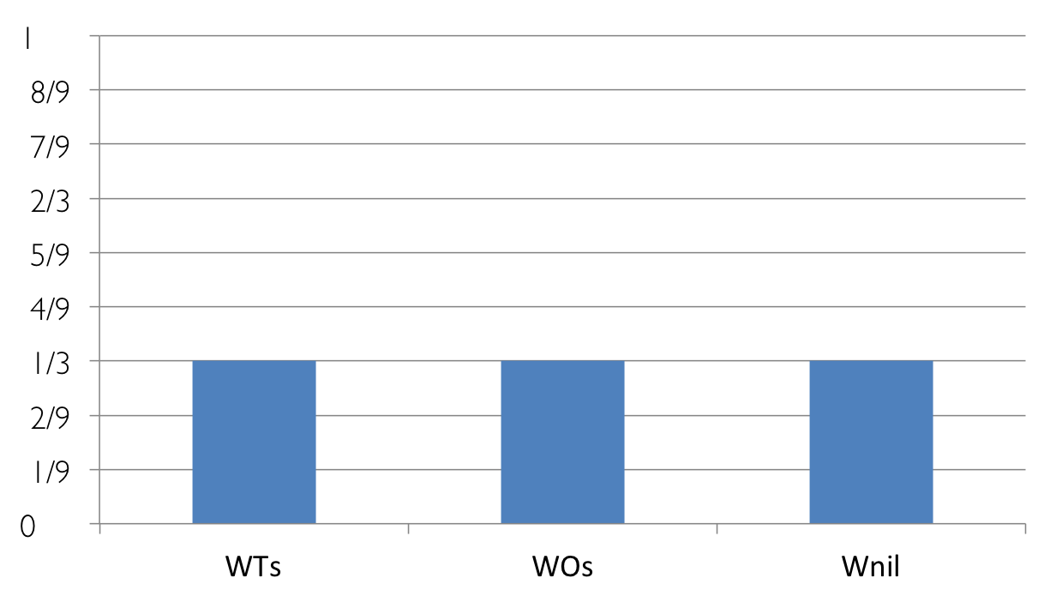
RE-WEIGHTING
SLIDE IMAGE CLASSIFICATION
Slide Image Classifier
1. Text
3. Drawing
2. Outline
4. Results
Initial Distribution
W_{Ts}
W_{Os}
W_{nil}
Notes:
TO MIN: This process was being done manually in the paper. The old way slide is available in the backup slides at the end.

Slide 24

RE-WEIGHTING
SLIDE IMAGE CLASSIFICATION
Slide Image Classifier
1. Text
3. Drawing
2. Outline
4. Results
Text Slide
W_{Ts}
W_{Os}
W_{nil}
Notes:
TO MIN: This process was being done manually in the paper. The old way slide is available in the backup slides at the end.

Slide 25
RE-WEIGHTING
SLIDE IMAGE CLASSIFICATION
Slide Image Classifier
1. Text
3. Drawing
2. Outline
4. Results
Outline Slide
W_{Ts}
W_{Os}
W_{nil}
Notes:
TO MIN: This process was being done manually in the paper. The old way slide is available in the backup slides at the end.

Slide 26
RE-WEIGHTING
SLIDE IMAGE CLASSIFICATION
Slide Image Classifier
1. Text
3. Drawing
2. Outline
4. Results
Drawing Slide
Leave weights as initially uniform
W_{Ts}
W_{Os}
W_{nil}
Notes:
TO MIN: This process was being done manually in the paper. The old way slide is available in the backup slides at the end.

Slide 27

EXCEPTION 1:RESULTS
SLIDE IMAGE CLASSIFICATION
Slide Image Classifier
1. Text
3. Drawing
2. Outline
4. Results
Results Slide
Ignore weights and
Align to “Experiment and Results” section
// end
W_{Ts}
W_{Os}
W_{nil}
Notes:
TO MIN: This process was being done manually in the paper. The old way slide is available in the backup slides at the end.

Slide 28
EXCEPTION 2: NIL CLASSIFIER
Use a heuristic to discard nil slides from alignment:
Nil factor =
If Nil factor > 0.40 → classify as nil
Notes:
TO MIN: did not mentioned in detail in the paper.
Kan used similarity score and wordcount as two important feature to classify nils.

Slide 29
FINAL ALIGNMENT VECTOR
Multimodal Alignment
Slide Image Classifier
nil
Pre-
processing
Text Alignment
Ordering Alignment
If the exceptions do not apply, i.e.,
the slide s was not a “Results” slide,
and it was not classified as nil,
Then:
s is aligned to the section with the highest probability in the final alignment vector:

Slide 30
EXPERIMENTS
For comparative evaluation
S1. Text-only Paragraph-to-slide alignment
To further the state-of-the-art
S2. Text-only Section-to-slide alignment
S3. S2 + Linear Ordering
S4. S3 + Image Classification

Slide 31

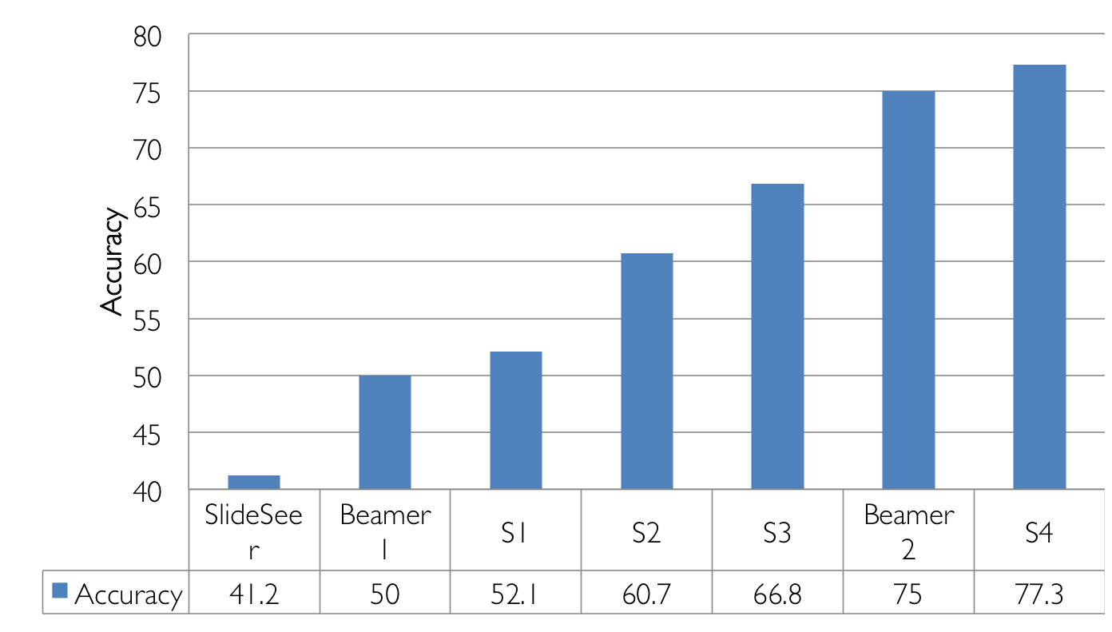
Results
16%
Baseline
Section
Ordering
Image Class

Slide 32
RESULTS BY SLIDE TYPE
Improvement in all categories
Especially in Image and nils
Number of slides
Recent Work. Not in published paper.
Notes:
TO MIN: this comparison was not done in the discussion part of the paper. In that time we didn’t have the result separately.
Nil improved 5.6% of overall accuracy. Reported before from 3 to 25.
Image errors: more than half, images of the text. So it is classified as Text, but no text can be extracted. And some charts may not report results, early analysis for example.
Slight improvement on Drawing and Text slides can be justified by ordering alignment, since nothing else has changed for them.
Text: 99 incorrect → 70 incorrect. From 409

Slide 33
SUMMARY
More than 40% of slides contain elements other than text
Baseline analysis shows the error rate:
13% of overall incorrect alignment on text slides.
26% of overall incorrect alignment on others.
We use visual content to classify the slides
Heuristic and weights depending on slide class
Final system (S4)
9 %
13%
50% reduction in targeted errors
Notes:
Change to 9% and 13%

Slide 34
CONCLUSION
Many slides with images and drawings, where text is insufficient evidence for alignment.
Visual evidence serves to drive the alignment:
As evidence (Image Classification)
As a system architecture driver (Multimodal Fusion)
THANK YOU
Notes:
For whatever processing you want to do on presentations, text is not enough.

Slide 35
Back up slides

Slide 36
APPLICATIONS
Help the process of learning for beginners by reviewing a paper along with its presentation.
Improve the quality of the skimming process for researchers and professionals.
Generate a large dataset of aligned slides and sections for the purpose of (semi-) automatic presentation generation.

Slide 37
FUTURE WORK
More accurate text similarity measures.
Differentiate between title and body text, and account for slide formatting.
Handling slides include hyperlinks, videos, animations, or other multimedia.

Slide 38
OLD SYSTEM ARCHITECTURE
Input: Presentation
Multimodal Fusion
Slide Image Classifier
1. Text
3. Drawing
Text Extraction
Textual Similarity
nil
2. Index
4. Results
Linear Ordering
Output: Alignment Map
Input: Document

Slide 39
OLD WEIGHT TUNING
1. Text
Text similarity alignment weight (W_{Ts}) → Increase 2/3
2. Outline
Text similarity alignment weight (W_{Ts}) → Decrease 1/3
Linear ordering alignment weight (W_{Os}) → Decrease 1/3
3. Drawing
Uniform probability for all weights
4. Result
Exceptional rule: Align directly to “Experiment and Result” section

